Slide 1
Project 1.2 2020-2021

Slide 2
Organisation

Slide 3

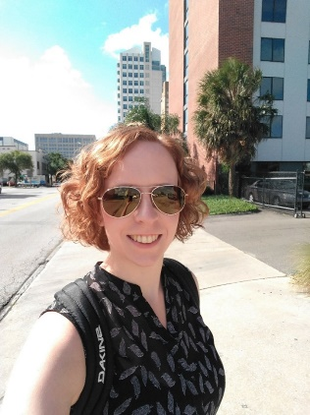
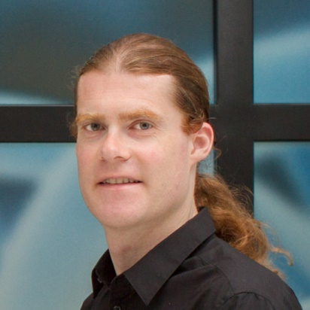
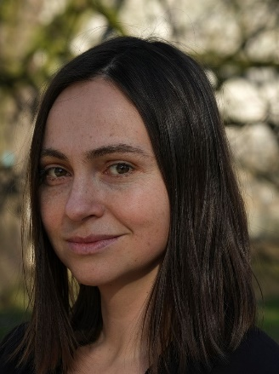
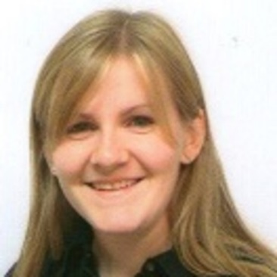

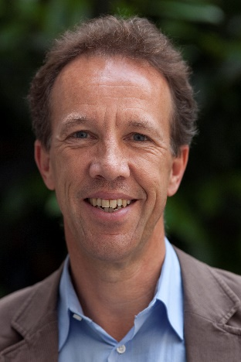
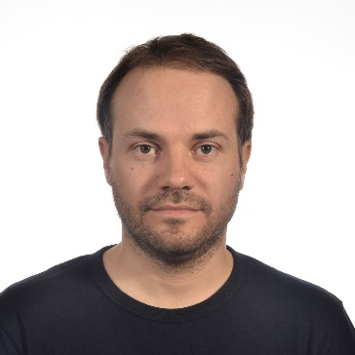
People involved
Tutors/project coordinator:
Examiners:
Daniel Campora
Katharina Schüller
Pieter Collins
Katerina Stankova
Chiara Sironi
Otti D’Huys
Christof Seiler
Nico Roos

Slide 4
Who is responsible for what?
Project coordinator
Everything related to organization
Examiners
Set up the project task
Assess you
Give feedback
Tutor
Guides you through the project processes

Slide 5
Addressing Questions
Questions about
Organization -> k.schuller@maastrichtuniversity.nl
Skill class content (lectures, assignments) -> Skill class teacher
Reasons for failing a certain skill class -> Skill class teacher
Group issues -> Your tutor
Library/tools usage -> Examiners + your tutor in cc

Slide 6
Phase 1
Only one week long
No courses, „just“ project
Project meeting with tutor: Monday and Wednesday
Deadline to upload code and presentation: Thursday night
Presentation/demonstration: Friday

Slide 7
Phase 2
7 project weeks
Project + courses
No project opening to start phase 2 -> we expect that you start working on the tasks of phase 2 immediately
Weekly/biweekly project meetings with tutor
Presentation/demonstration at the end of week 7

Slide 8
Phase 3
Only 3 weeks long
No courses, „just“ project
About two project meetings per week
Pre-examination in week 2
Not graded
For you to receive feedback from examiners
Presentation in week 3
For general audience
Product & report examination in week 3
Nasty questions from examiners on product
Feedback on report

Slide 9
Project meetings
Concrete time schedule is uploaded to Canvas
15 minutes long
Take place in zoom
Group is responsible for choosing a person to take minutes
Group is responsible for choosing a person that chairs the meeting (based on agenda)
Agendas/minutes need to be uploaded to Canvas

Slide 10
Uploading Submissions
Upload to Canvas
Assignment with due date
Late submissions will potentially have points deducted, or not be marked at all
Code as zip file including
Readme file that describes how to run your code
All necessary files to run your code
Presentation as PDF or Powerpoint presentation

Slide 11
Presentations/ Demonstrations
Take place in collaborate ultra
Examiners will enter the sessions one after each other
Make sure to be prepared to directly start (share slides, ready to share screen where software can be shown, test micorphone and video)
Phase 1: 10 minutes presentation including a demonstration + 10 minutes questions from examiners
Everyone needs to present, everyone needs to answer questions

Slide 12
Deliverables
Phase 1: Presentation, Code, Overview of who did what, Agendas, Minutes
Phase 2: Presentation, Code, Overview of who did what, Planning, Agendas, Minutes
Phase 3: Presentation, Code, Report, Overview of who did what, Planning, Agendas, Minutes

Slide 13
Assessment
Phase 1 counts 15%, phase 2 counts 15% and phase 3 counts 70% for final grade
Assessment forms available on Canvas -> READ THEM
It is not needed to pass each phase to pass the project
Individual deviations from group grade are possible if
You miss/do not prepare for skill classes
You miss assessment moments
You miss/do not contribute to project meetings
Your performance is outstanding
Your performance is very bad

Slide 14
Missing Project Meetings
One meeting per phase can be missed without consequences
If you miss more, you need a good excuse for all meetings (save the proofs) or your grade is reduced
NG if you miss 3 or more PMs in a phase!!!

Slide 15
Missing Skill Classes
Missed a skill class? -> ILOs missed
Thus, 0.5 points will be reduced from final grade
If you will receive an NG due to too many missed skill classes -> ask BoE to excuse you at the end of the project (only if you have good reasons)
Keep track on your failed skill classes yourself

Slide 16
Necessary Information
All information can be found on Canvas
Rules and Regulations
Project Manual
Project Opening Slides
…
Any questions? -> email me (k.schuller@maastrichtuniversity.nl)

Slide 17
Any questions?

Slide 18
Project Topic
Flight to Titan

Slide 19
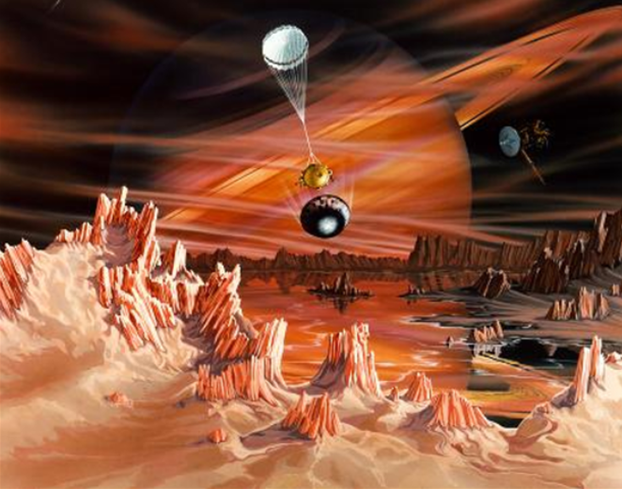
Flight to Titan

Slide 20
Overall Task
Mission to bring a manned mission to Titan (moon of Saturn) and back
Develop and launch a spacecraft and bring it safely into the orbit around Titan
Land on Titan
Leave the orbit and bring the crew back to earth

Slide 21
What do you need to solve this task?
Data positions and velocities of the planets
Physical constants (e.g. gravity)
Newton‘s law of dynamics and mechanics
Newton‘s law of universal gravity
Kepler‘s laws

Slide 22
Task description
A detailed description of the tasks can be found in the project manual
Here, we focus on the most important parts to give you a first idea of the project
You may need some more explanations from the project manual to complete the tasks

Slide 23


Phase 1 – Base model
Acquire data to build a mathematical model of the sun, planets and their moons https://solarsystem.nasa.gov/planets/saturn/overview/
Physical engine capable of computing the paths of all planets and co. and the trajectories of your spaceship
Visualization of the planetary system and the trajectory of your spaceship

Slide 24
Phase 1 – Exploratory Mission (Mission 1)
Launch a space probe using a ballistic missile
Like a bullet from a canon
Only focus on gravitational forces
No engines, no thrust
Requirements
Probe must be launched on April 1st, 2020
Probe must be launched at a point on earth surface
Maximal initial velocity 60km/s
Probe must reach Titan before April 1st, 2021

Slide 25
Phase 1 – Solver Requirements
Use the same x-y-z coordinate system used by NASA Horizons
Model the sun, the 8 planets, the Earth‘s moon Luna and Titan
Use standard SI units (kilograms, metres, seconds)
Launch positions and velocity of objects relative to the Earth‘s position and velocity
You must give the time of the closest approach of the probe to Titan
Use Euler solver with fixed step-size
Output the complete trajectory of your space probe

Slide 26
Phase 1 – Implementation and Testing
Your code will be automatically tested -> conform to the API uploaded to Canvas (three java files)
Test you physics engine with various step-sizes
Ideas for research questions are in the project manual
For testing, you may omit Mercury, Venus, Uranus, Neptune, Moon and Mars

Slide 27
Phase 2 – Mission 2
Fully-fledged multiple-stage rocket is now your spacecraft
Launch it from Earth such that it enters the orbit around Titan (no landing yet)
Rocket engine to correct the trajectory
Every correction will burn mass (fuel)
Bring your astronauts back to Earth again

Slide 28
Phase 2 – How?
Use higher-order differential equations to model the mission (Runge-Kutta, Verlet)
Test different step-sizes
Minimize fuel costs while complete the mission in reasonable time
Write simple Junit test cases (100% coverage)

Slide 29
Phase 3 – The Landing
Improve your phase 2 work
Spaceship is in the orbit of Titan
Launch landing module from spaceship
Non-zero horizontal velocity of landing module

Slide 30
Phase 3 – How?
Write a physics engine that simulates the motion of the landing module
Include rotations of the landing module as well as horizontal and vertical motion
Try to controll the landing on Titan by:
Open-loop controller: Determine in advance your input functions based on the given initial position of the landing module
Feedback controller: Determine the thrust based on the current position and velocity
Include wind in your model

Slide 31
Grading
Minimum requirements to pass each phase is given in the project manual
Ideas on how to get a higher grade are stated in the project manual as well

Slide 32
Any questions?

Slide 33
What now?
Meet your group in Collaborate Ultra
Leave the zoom session open (attendance track)
Discuss how your are going to start working on the project
Next project meeting already on Monday
After tracking the attendance, I will let you know that you can leave (until then, stay in the zoom session)
Any questions? -> ask them in the chat in zoom session (including your group number)

